Slide 1
Kriya Mudra and Bandha
Procedure and Effect

Slide 2
Definition of Kriya
Kriyas in yoga are a series of techniques that purify the body.
These have been practiced by yogis in ancient times, now becoming more popular around the world.
Kriyas improve digestion, boost energy levels, reduce common illnesses and bring about greater bodily awareness.
There are many different types of kriyas in yoga.

Slide 3
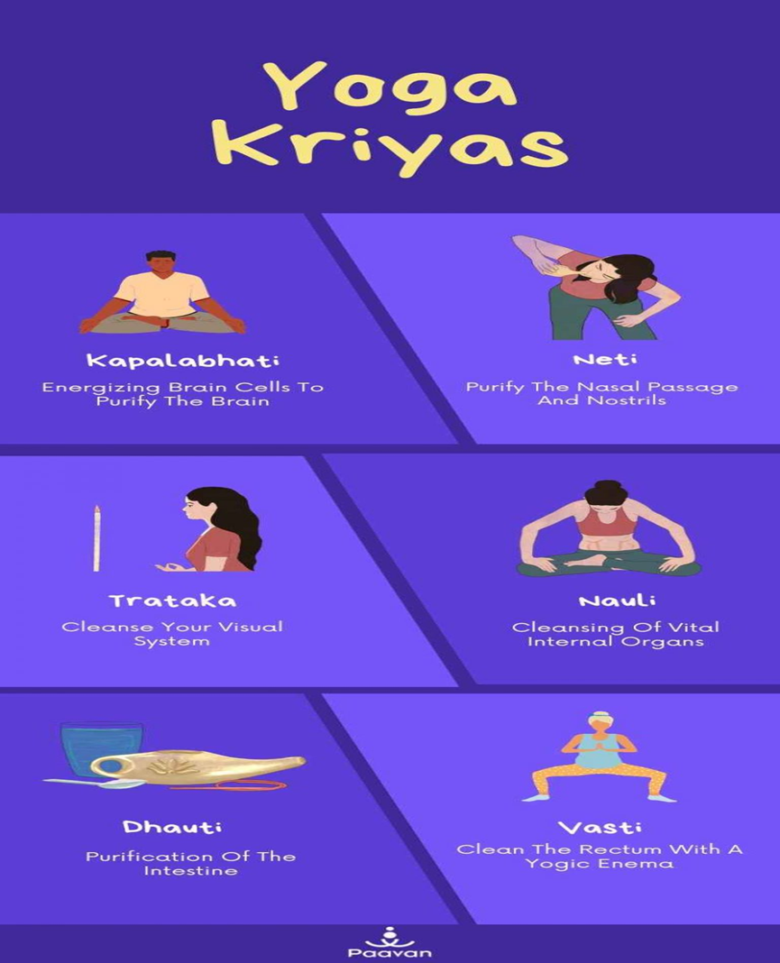
Six types of Kriyas
Kapalabhati
Neti Kriya
Tratok Kriya
Nauli Kriya
Dhauti Kriya
Vasti Kriya

Slide 4
1. Kapalabhati – Energizing Brain Cells To Purify The Brain
It is a breathing technique that purifies the front area of your brain, purifying the nasal passage and respiratory system. This yogic kriya is practiced to purify the brain cells and polish the mind.
Begin this yogic kriya by sitting in a laid-back straight posture. Place your both hands on the lap or you can also place your one hand on the lower abdomen. Placing one hand on the abdomen can make you experience this yogic kriya.
Deeply inhale with your nose using your abdominal contractions and exhale. Keep exhaling rapidly. Exhale slowly in the first round and then increase the exhaling speed. It is excellent for stimulating abdominal organs and improving digestion.

Slide 5
Kapalabhati kriyas in yoga involve intense breathing that removes respiratory blockages detoxifying the whole lymphatic system.
This energizing breathing practice should be practiced in the morning on an empty stomach, for maximum benefits. While practicing this technique, make sure you do not exceed 150 to 200 repetitions at once.
Kapalabhati kriyas in yoga are not recommended for people with eye problems, high blood pressure. It also generates heat in the body which is why it is recommended to practice in the morning.

Slide 6
2. Neti Kriya
Neti kriyas in yoga involve 4 different techniques where various mediums including water, ghee, milk, or a thread are utilized to purify and clear the nasal passage. Nostril cleansing helps avoid irregular breathing and associated nasal ailments.
This yogic kriya is extremely advantageous for a youthful glow. It releases tension from facial muscles. It also relieves depression, anxiety, and other mental congestion balancing the whole nervous system. Neti kriyas in yoga improve energy and clarity.
It helps to treat diseases like insomnia, migraine, asthma, sinusitis etc.

Slide 7
3.Trataka – Cleanse Your Visual System
Trataka kriya is an eye technique. This kriya in yoga promotes healthy eyesight, develops focus, and boosts physical and mental dedication.
It involves fixing your stare slowly at an object and continuing without blinking your eyes. This practice activates tear glands cleansing your visual system.
Trataka Kriya improves eyesight and increases concentration.
It includes two types of kriyas Jatra and Jyoti. While practicing it, make sure your eyes are relaxed throughout the process. It secrets tear glands that contribute to the purification of the visual system

Slide 8
4. Nauli – Cleansing Of Vital Internal Organs
It is also called stomach churning. Nauli kriyas in yoga cleanse and reinforces your imperative internal organs. It stimulates the functioning of the liver, spleen, and other internal organs relieving constipation and other digestive issues. This essential kriya is practiced in order to purify and tone the internal organs placed inside the abdomen.

Slide 9
To perform these types of kriyas, you must stand straight, keeping both feel wider. Slightly bend forward from your hips, keeping your back straight. Take a deep breath, exhale, pull your navel towards the spine, draw the stomach in, and form an abdominal energy lock or Uddiyana Bandha. Hold it as long as you can with ease, without forcing your body. Repeat the same technique twice again.

Slide 10
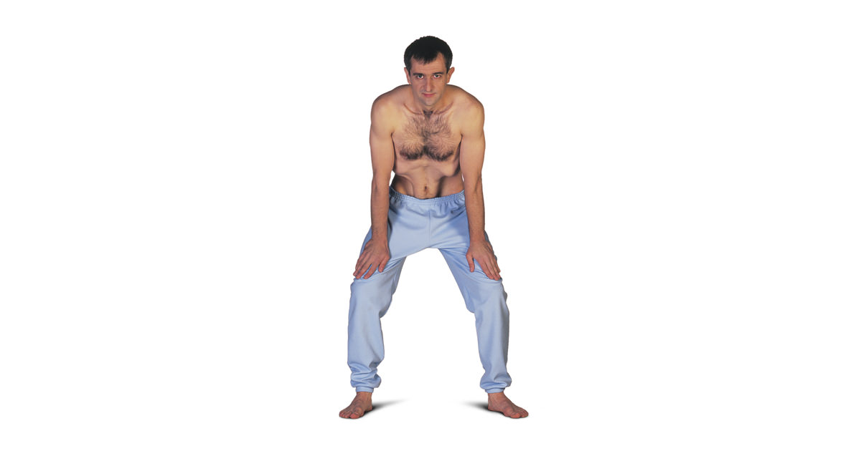
Image of Nauli Kriya

Slide 11
5. Dhauti – Purification Of The Intestine .
There are three types of dhauti kriyas in yoga which are extremely helpful to relieve acidity, gastric issues, and asthma. It is particularly performed to cleanse the upper intestine. Dhauti is the most demanding yet tremendously beneficial yogic kriya after Nauli. It is performed to induce vomiting in order to clear obstructions or impurities in the intestine.

Slide 12
Dhauti
Three types of dhauti kriyas are Jala, Vastra, and Danda Dhauti.
These are particularly advantageous to treat bile disorders and gastric troubles. It also improves renal functions and removes harmful worms from the liver.
The process cures acidity, bile, indigestion , diseases related to cough, spleen etc.

Slide 13
6. Vasti – Clean The colon with a Yogic Enema
Our abdomen has three parts: upper, middle, and lower abdomen. Vasti kriya is practiced to cleanse your lower abdomen including the bladder and pelvic zone. It is also called a Yogic Enema as it is inclined to remove the impurities from the colon.
Vasti kriyas in yoga are highly beneficial for curing and avoiding urinary disorders, and digestive issues, preventing irregular bowels, eradicating diseases such as bile and flatulence, etc. It also tones lower abdominal muscles.

Slide 14
Benefits of Kriya
A tonic for your well-being: Committed practitioners acknowledge the incredible properties of kriya yoga. It can rapidly detoxify, revitalize and uplift your mind, body, and soul.
Utmost weapon against diseases: When you regularly practice yogic kriyas, you have an excellent ability to fight illnesses from within. That means battling certain diseases is easy.
Be in charge of your mind: The human mind is prone to get distracted and distressed. Certain types of kriya yoga allow complete control of your mind. Deep breathing techniques also enhance focus and memory.
Stimulate your Kundalini energy: Kriyas in yoga help the practitioner activate Kundalini energy in the shortest time. It prompts your spiritual growth and helps attain the ultimate goal of spirituality.
.

Slide 15
Benefits of Kriya
Accelerate your personality and intellectual growth: Kriya yoga enhances circulation in brain cells resulting in less tiredness and a sharper mind. Regular practice helps you avoid negativity, supporting and sustaining complete personality transformation.
Strengthen your concentration and willpower: Yogic kriyas alter your perceptions for the better. The techniques expel negative feelings such as anger, fear, resentment, low self-esteem, and doubt that may be prowling deep inside you.
Vanish your ego: Practicing different types of kriyas yoga melts your ego and brings the light of bliss. You feel truly being yourself, more connected to your inner self and with the infinite

