Slide 1



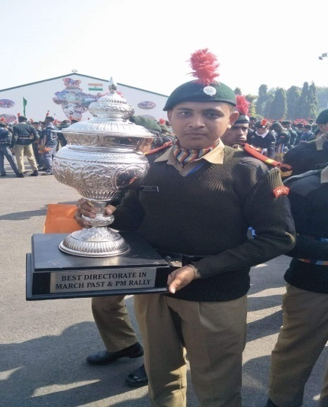
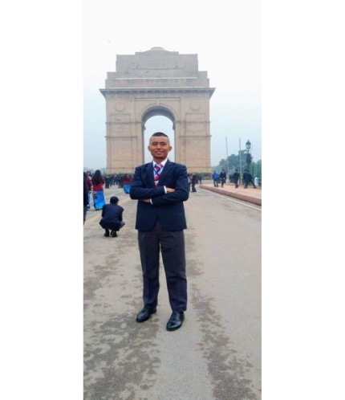
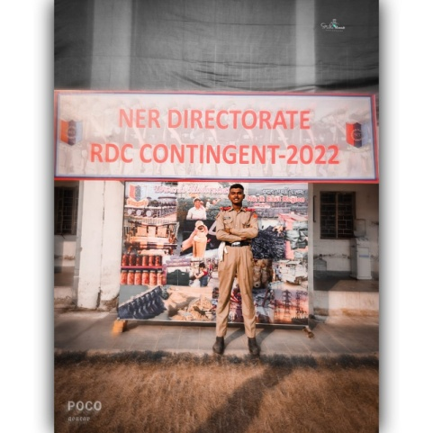
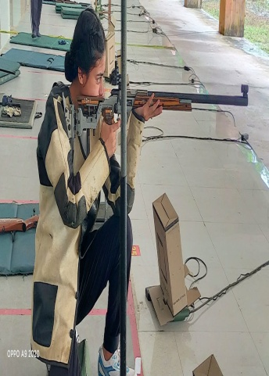
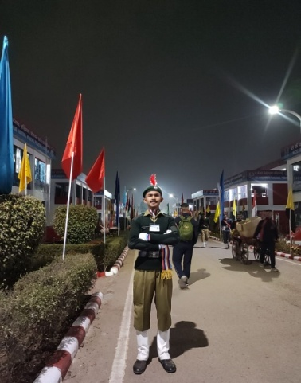
DHSK COMMERCE COLLEGE,DIBRUGARH 10th ASSAM BN NCC, DIBRUGARH NCC ENROLLMENT 2023 OPPORTUNITIES TO ATTEND MAJOR CAMPS LIKE YEP,RDC,TSC,EBSB,ARMY ATTACHMENT CAMPS ALONGWITH PERSONAL DEVELOPMENT, ACADEMIC AND CAREER BENEFIT , AND MANY MORE...
SOME ACHIEVEMENTS OF OUR CADETS AT RDC AND NATIONAL LEVEL CAMPS TILL 2023
HURRY !!! LIMITED SEATS, STUDENTS OF 1^{ST AND} 3RD SEMESTER ARE PREFERABLE
YOU CAN CONTACT AND WHATSAPP YOUR NAME IN ADVANCE TO :
ANO LT.BORSING HANSE ( 7002405044)
SENIOR: SUDARSHAN KALITA ( 8822082739)

