Slide 1
What is Communication

Slide 2
Communication
From the Latin word “Communicare”(to share) or “Communis” (to make common)
-Act of transferring/transmitting & receiving ideas, information and message from one person to another
Two way process between SENDER & RECEIVER
A dynamic process, continuous process
Information, ideas & messages are transmitted through mutually understood signs
-It is the creation and exchange of meaning

Slide 3
Objective of Communication
Deliver a message, idea & information
Create Understanding
Definitions-
Keith Davis- Communication is a process of passing information and understanding from one person to another
Louis Allen- Communication is a bridge of meaning. It involves a systematic and continuous process of telling, listening and understanding.

Slide 4
2 Basic types of Communication- Oral & Written
The Process of Communication-
Communication is the active process of sending and receiving messages through verbal & non verbal means including speech (words & language), writing and graphical representations (pictures, maps, chart), signs & signals and behaviour.
-The process of communication involves various stages/ components.
- It is related with sharing & understanding of information.

Slide 5
The components in the process of Communication- 7 basic components
Sender- the person who send the message
Encoding- the mental preparation, the process of organizing ideas/ information into words, symbols and other form of expression.
Message- the physical form of the idea, information & message
(Meaning lies in the receivers mind not in the message)
Channel- the medium & method of delivering the idea
Receiver- the person who receives the message
Decoding- the process of attaching meaning to sender’s message—understanding/ comprehending the message
Feedback- response or reply to sender’s message.

Slide 6
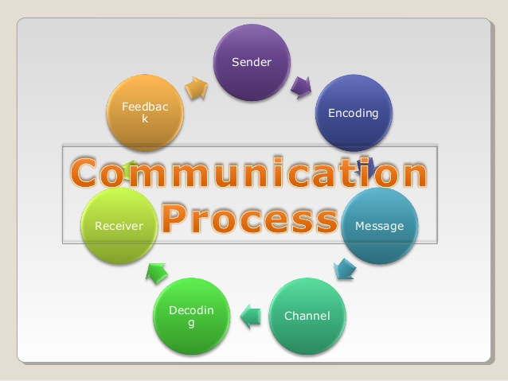

Slide 7
Importance of Communication in organization
Creation of conducive environment- conducive environment of understanding can be created
Promote Work Culture- successful & smooth running of the organization to promote goals and policies
Basis of managerial function- helpful in management of organization, planning, organizing, leading, directing, motivating & controlling
Builds human relationship- two way communication promotes mutual co-operation and understanding.
Job satisfaction & enrichment- overcomes illusion and misunderstanding, enhances morale and job satisfaction.
It facilitates decision making by providing necessary information in time.

Slide 8

Basic forms of communication
One Way Communication-
absence of feedback
Sender and receiver are isolated not interdependent
Examples- TV News, Radio, Movies etc.

Slide 9
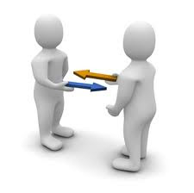
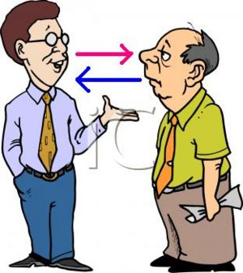
Two Way Communication
Effective/Active feedback from receiver
Receiver understands the message in the same sense and spirit that the sender intended.

Slide 10
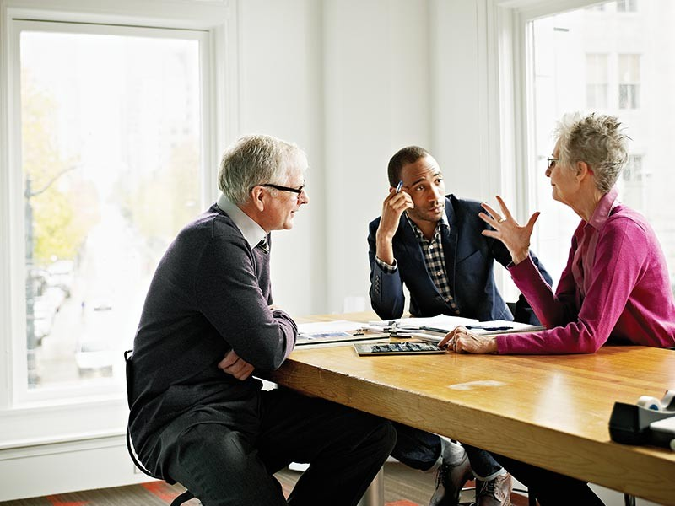
Verbal & Non-verbal Communication
Verbal- Communication through spoken & written word
2 types- Oral & Written

Slide 11

Non-verbal Communication

Slide 12
Transmission of message with the help of facial expression, body posture, eye contact, clothing, silence etc.
Communication through sending and receiving wordless cues.
It includes the use of visual cues such as body language (kinesics), distance (proxemics) and physical environments/appearance, of voice (paralanguage) and of touch (haptics). It can also include the use of time (chronemics).
More than 65% human communication is through non-verbal cues.

Slide 13
Formal & Informal Communication
Communication inside the official set up regarding official matters
It is structured on the basis of hierarchy, authority & accountability
Information can move both horizontally & vertically
Examples- Departmental meetings, conferences, circulars, company news, interviews etc.

Slide 14
Informal Communication
Communication of the members of the organization regarding unofficial matters
It takes place outside the formally prescribed & planned network or channel
It is spontaneous & off the record communication between peers, colleagues, classmates etc.
No set rules & regulations and no particular direction.

Slide 15
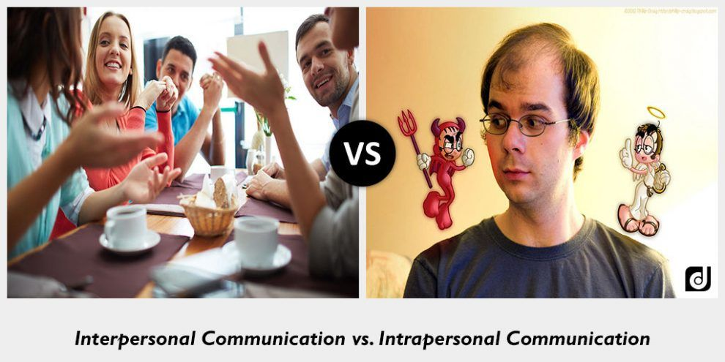
Intrapersonal & Interpersonal communication

Slide 16
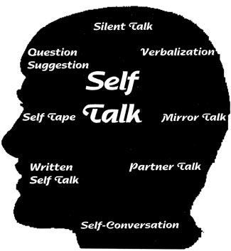
Intrapersonal communication
Internal dialogue, thinking, self-talk of an individual
It may be clear or confused depending upon the individual’s state of mind.

Slide 17
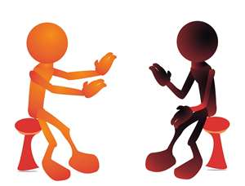
Interpersonal Communication
It is the communication among two or more persons
It signifies positive, personal and internal relationship between the persons involved

Slide 18
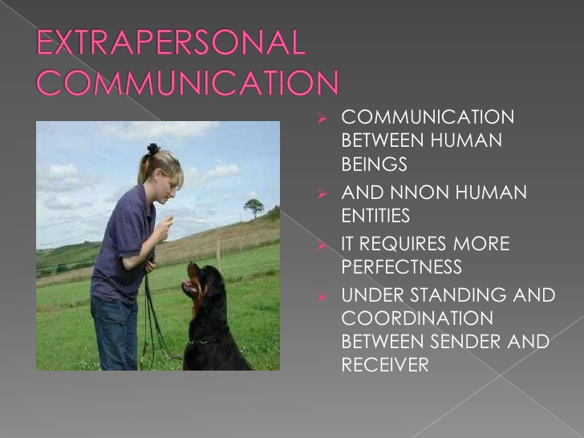

Slide 19

Group Communication
Two or more persons interact with each other
It is extension of interpersonal communication
The group must be formed intentionally or voluntarily to communicate on an important matter- committees, team members etc.

Slide 20

Public Communication
It is a speech given by one person to a large group of people
It is one way communication because there is no scope to give immediate response.

Slide 21
Mass Communication
It is the process of communication to the general public at large through different mass medias such as television, films, internet, publications etc.

